Slide 1
ANALYSIS OF RENT ACCOMODATION PRICES IN PORTO

Slide 2
Background
To organize outstanding trip every traveler needs an advice in booking of most comfortable and suitable apartments. It requires a lot of efforts to find ideal place in a big unfamiliar city like Porto.
Let me introduce an outstanding solution of the problem: a map with average price per apartments visualization and venues divided by clusters according to characteristics of each neighborhood.

Slide 3
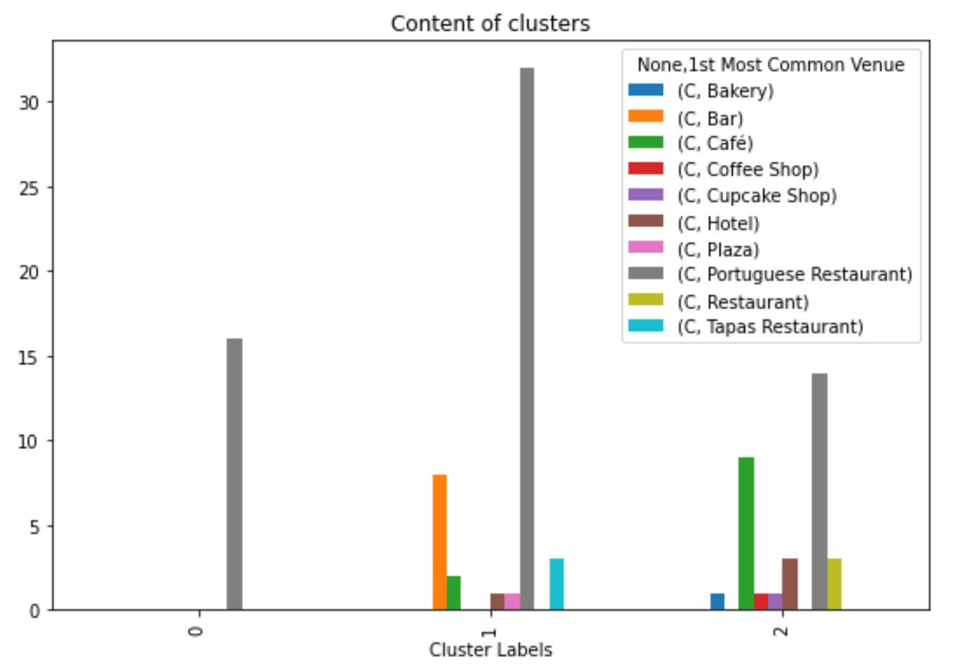
clustering
We have some common venue categories in hosts. In this reason I used unsupervised learning K-means algorithm to cluster the hosts. K-Means algorithm is one of the most common cluster method of unsupervised learning.
0 Cluster: Portuguese Restaurant
1 Cluster: Portuguese Restaurant, Bar, Tapas Restaurant
2 Cluster: Portuguese Restaurant, Café, Hotel

Slide 4
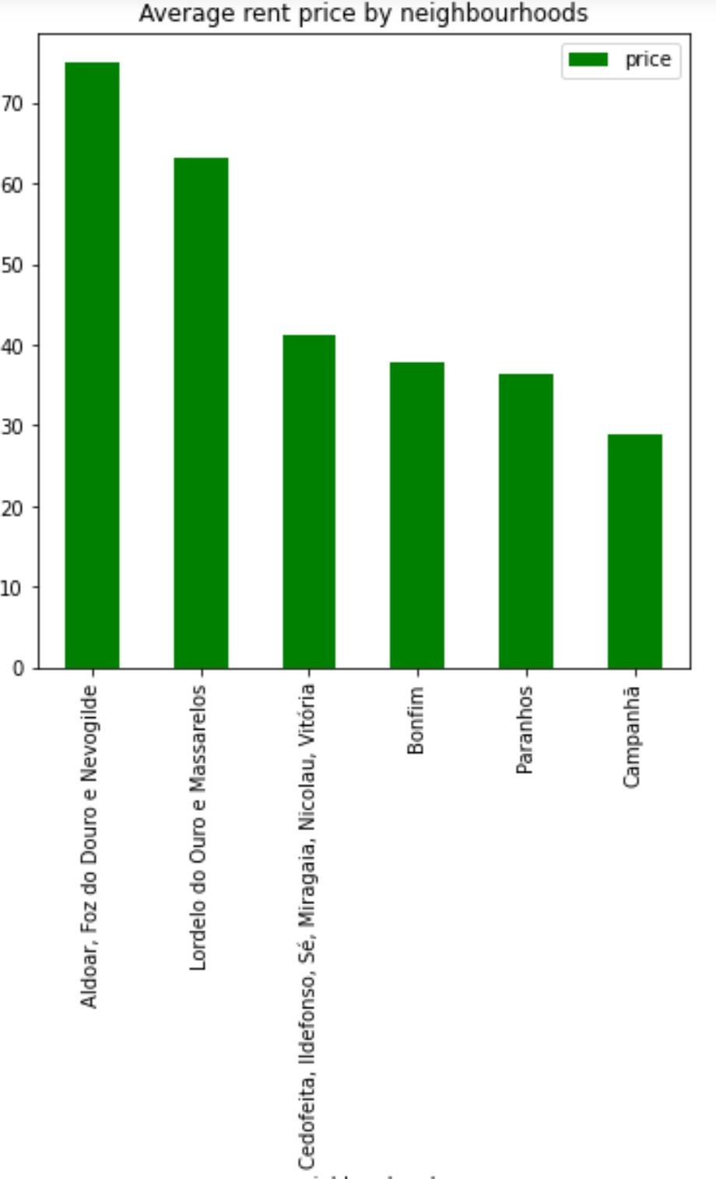
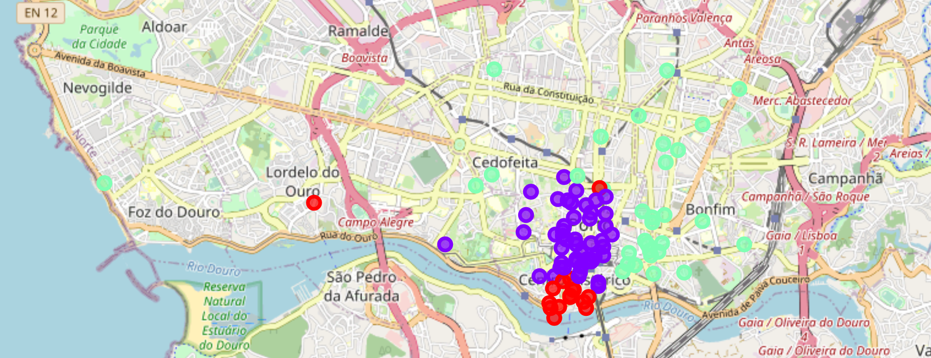
Results

Slide 5
conclusion
Data science tools give access to individual analysis approach for users. The model is applicable for any city and is really useful for travelers because provides an opportunity to predict options of certain accommodation in unfamiliar city.

